Slide 1


Non-invasive continuous monitoring ecosystem with IOT & ML for an affordable healthcare
TECHNOVATION PRIVATE LTD.

Slide 2


Diabetes in India
Over 77 million adults in India are affected by type 2 diabetes, a staggering number that highlights the significant market potential for our products and services.
Less than 1% of individuals with diabetes consistently monitor their glucose levels. Most of the patients fail to monitor due to the inconvenience and high costs associated with Invasive methods that involve pricking the skin and using expensive test strips. Our solution effectively tackles these challenges by enabling continuous and affordable glucose monitoring, providing expert analysis, and offering effective solutions to control glucose levels. This will significantly enhance health monitoring for a wider population and effectively mitigate risks.
A concerning fact is that only 50% of the 77 million people living with diabetes in India are aware of their condition. By offering a user-friendly and cost-effective screening solution, we aim to increase awareness and help individuals identify and manage their diabetes at an early stage, leading to better health outcomes and reduced healthcare costs. A significant stride towards proactive preventive healthcare.
India currently imports glucometer strips worth 900 crores in a year and that's the market we aim to disrupt.

Slide 3
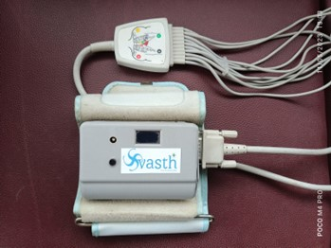
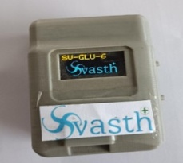
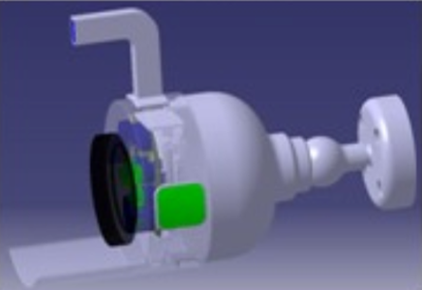
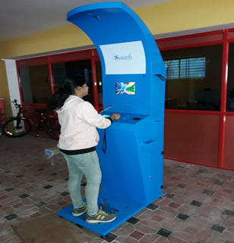
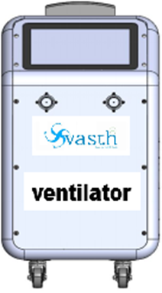
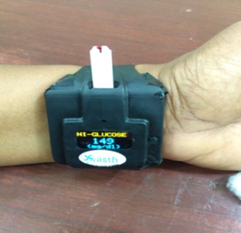

Our Vision
Our vision is to create innovative, advanced medical devices and other embedded technology-based solutions that leverage the Internet of Things, Machine Learning, and Bio-Medical Engineering. Our focus is on developing non-invasive, continuous monitoring devices that track vital health parameters such as diabetes, heart rate, SPO2, hemoglobin, blood pressure, cardiology metrics, and ventilator data. We are committed to providing affordable, preventive health monitoring solutions and fostering an ecosystem approach to promote holistic well-being.

Slide 4
Svasth+ Ecosystem – Value Proposition
SVASTH NON INVASIVE, CONTINUOUS, HEALTH
Svasth wearables are specifically designed for Type I & Type II Diabetes patients, as well as Gestational Patients, providing continuous glucose monitoring (CGM), HEMOGLOBIN HEART RATE, SPO2,TEMPERATURE.
Svasth Capillary Pulse monitors also BP in addition to Wearab;es Parameters of In Patients and Gestational patients at regular intervals, generating real-time reports.
Svasth Kiosk is aimed at providing affordable preventive healthcare in primary health centers (PHCs), hospitals, and offices, allowing patients to monitor their health and consult with doctors.
Svasth promotes awareness among individuals about monitoring vital health parameters without the need for painful pricking and the high cost of test strips (Rs 45 per day/ Rs 1200 per month).
Svasth provides value-added information to doctors, enabling them to understand the impact of medications and revise prescriptions at regular intervals, eliminating the need to wait until the next visit.
Svasth utilizes IoT, ML-based analytics, and predictive reports to offer health insights and actionable information.
Svasth aims to facilitate early detection of conditions such as Diabetes, Blood pressure, Anemia, and other vital parameters, providing suggestions for preventive healthcare.
SVASTH Apps & Ecosystem
Empowering Unemployed Youths: Svasth+ focuses on skill development, training unemployed youths to manage our Kiosks in rural and urban areas.
Seamless Patient-Doctor Integration: Svasth+ integrates patients and doctors through our Miisky Software, enabling effective communication and mapping.
Collaborative Support Network: Svasth+ connects with nutritionists, health experts, and NGOs to provide comprehensive support to patients.
Government Partnership: Svasth+ supports the government's rural health programs, contributing to their success.
Technology Collaboration: Svasth+ collaborates with technology companies to enhance serviceability and provide cutting-edge solutions.
Streamlined Vaccination and Healthcare Initiatives: Svasth+ facilitates focused vaccination drives, pulse polio campaigns, and other healthcare initiatives.
Effective Communication in Local Languages: Svasth+ communicates government schemes and initiatives in the users' preferred language.
Comprehensive Training Programs: Svasth+ offers training in CPR, first aid, and other vital skills.
Seamless Integration with Ambulances and Hospitals: Svasth+ establishes connections with ambulances, hospitals, and healthcare facilities for swift access to medical services.

Slide 5
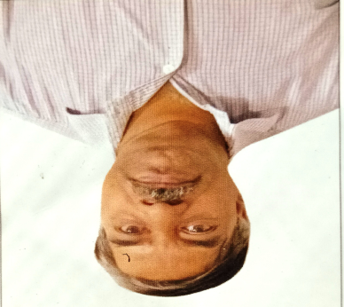
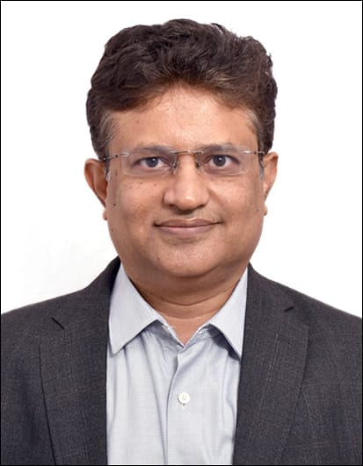
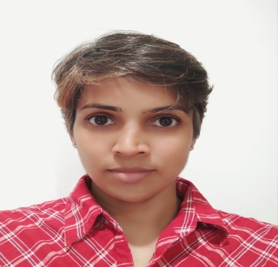
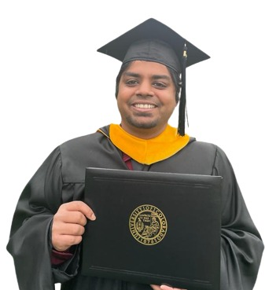





Key management team and advisors
Founder & CEO
Co-Founder
Advisors
Advisors
Advisors
Management
Mentor
Co-Founder
Advisors
SOLVMINDS
G Jagannathan
Dr. Satish babu KN
Supraja Srinivasan
Sudarshan Jagannathan
Dr. Hardik Pandya
Dr Mohan Rao
Dr. H.R Gundu Rao
Dr. Shyam Kalapavalli
Solvminds
- Innovating entrepreneur
- Qualified Finance Professional
- Educationist
- Founder & CEO of AARMS Value chain Pvt. Ltd., Focused on end to end AR Management
- MBBS, MD - General Medicine,
- MRCP (UK)
- HOD Endocrinologist – Sparsh hospitals, Bangalore
BE Medical Electronics Engineer​
MS in Electrical, Computer and Energy Engineering (Embedded Systems and IoT Professional MS) from the University of Colorado Boulder.
Dept of Electronic Systems Engg, Biomedical and Electronic Engg Systems Laboratory IISc`
Hod endocrinology, rajarajeswari hospitals
Professor Emeritus, University of Minnesota
Endocrinologist, IDEA CLINICS
Operational Management team Accelerating growth for startups

Slide 6
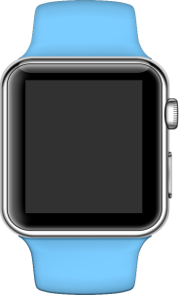

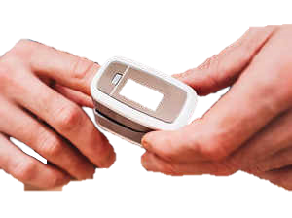


Our 3 flagship products - Svasth Glucowatch, Svasth Capillary – Non-invasive Glucometers & Svasth Healthscans(Kiosks)
Non-invasive Continuous monitoring Glucometer
Non-invasive capillary based Glucometer
Svasth Healthscans(Kiosks)

Slide 7

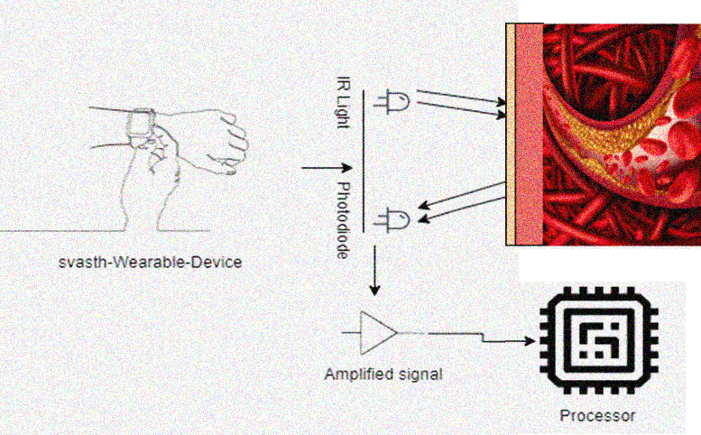
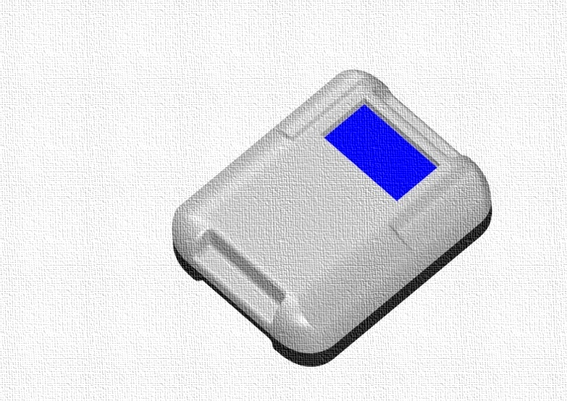
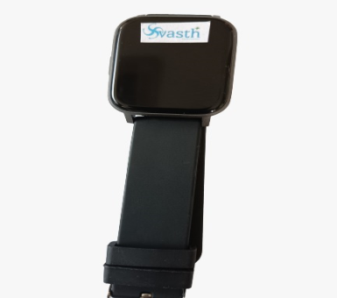

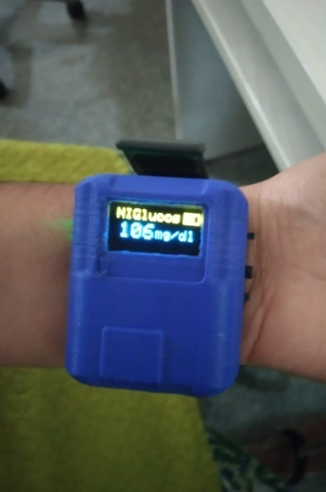


Our journey in Wearables
Idea to a product
Glucose Monitoring using NIR
Svasth-Wearable-Device
Fabricated prototype of Svasth Glucowatch
Fabricated prototype of Svasth Capillary
Rendered Image of Svasth Healthscan

Slide 8
Svasth Wearables
All Svasth readings within the range of +10 to -10% of Lab readings

Slide 9
Pre-revenue expenses

Slide 10
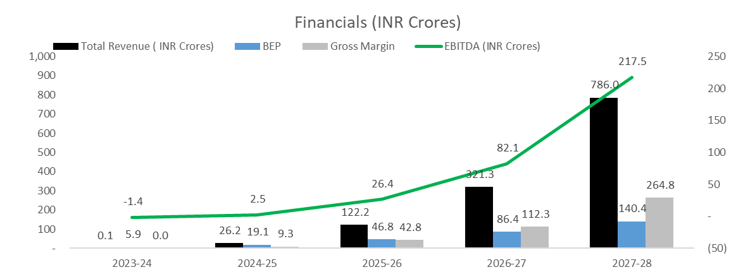
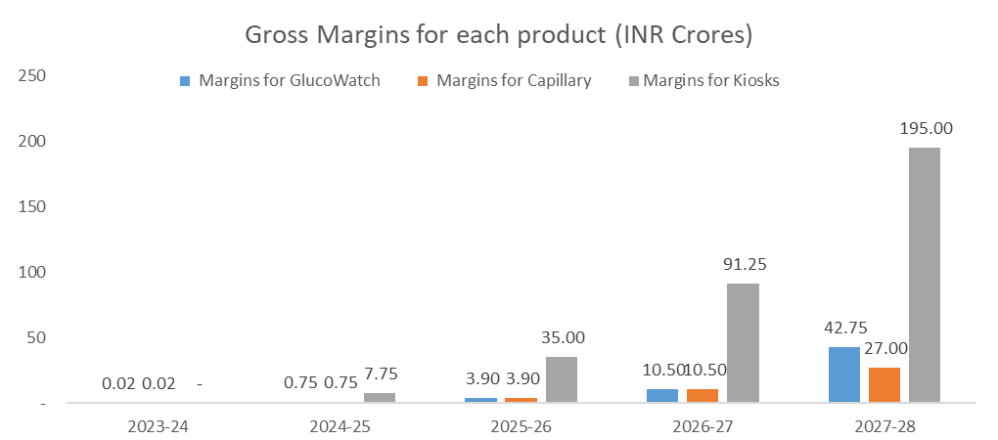
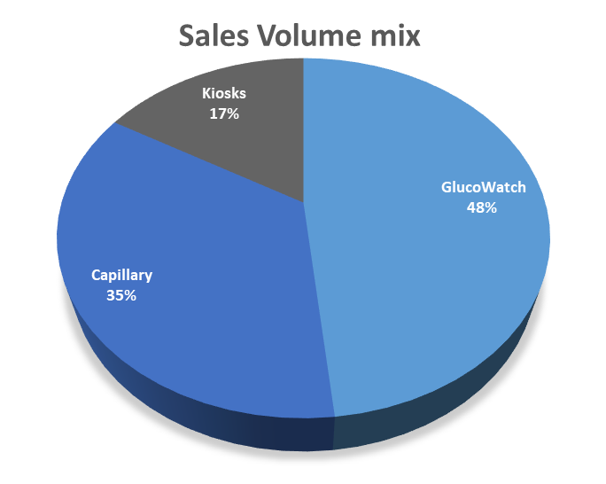
By addressing challenges of less than 2% of diabetes patients in India, we can be profitable by year 2024-25

Slide 11

Funding needs
Round 1 1 Cr
Commercial production
Technology, Software, Certifications and Clinical Trials.
1000 units of Wearables & introduction of Kiosks
Q1’23-24
Q2’24-25
Q3’23-24
Q3’24-25
Assembly of first 100 units for market
Positive EBITDA
Clinical Trials
Round 2
1.5 Cr
Kiosks

Slide 12

Next Steps
 | Q2 FY 23-24 |  |  | Q3 FY 23-24 |  |  | Q4 FY 23-24
 | July | Aug | Sep | Oct | Nov | Dec | Jan | Feb | Mar
PCB Design
Design & 3D printing of 10 units
Clinical trials of 100 patients
Clinical trials for 10000 patients - Venous & Accucheck
Certifications and approvals
Design & Mfg of Mechanical assembly
Manufacturing & Assembly of 100 units for pilot
Development of ecosystem - Apps, Analytics
Kiosk Design & Assembly
Marketing & Promotions

Slide 13
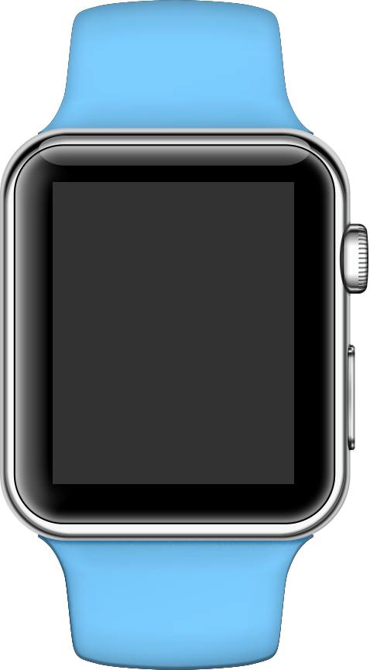

Q&A
For any queries, please reach out to
g.jagan@aarmsvaluechain.com

